Slide 1
School of Computing Science and Engineering
Course Code: BCSE2350 Course Name: Cryptographic Fundamental
Authentication Applications

Slide 2
Authentication Applications
will consider authentication functions
developed to support application-level authentication & digital signatures
will consider Kerberos – a private-key authentication service
then X.509 - a public-key directory authentication service
Notes:
This chapter examines some of the authentication functions that have been developed to support application-level authentication and digital signatures.
Will first look at one of the earliest and most widely used services: Kerberos. Then examine the X.509 directory authentication service.

Slide 3
Kerberos
trusted key server system from MIT
provides centralised private-key third-party authentication in a distributed network
allows users access to services distributed through network
without needing to trust all workstations
rather all trust a central authentication server
two versions in use: 4 & 5
Notes:
Kerberos is an authentication service developed as part of Project Athena at MIT, and is one of the best known and most widely implemented trusted third party key distribution systems.
Kerberos provides a centralized authentication server whose function is to authenticate users to servers and servers to users. Unlike most other authentication schemes, Kerberos relies exclusively on symmetric encryption, making no use of public-key encryption. Two versions of Kerberos are in common use: v4 & v5.

Slide 4
Kerberos Requirements
its first report identified requirements as:
secure
reliable
transparent
scalable
implemented using an authentication protocol based on Needham-Schroeder
Notes:
The first published report on Kerberos [STEI88] listed the requirements shown above. To support these requirements, Kerberos is a trusted third-party authentication service that uses a protocol based on that proposed by Needham and Schroeder [NEED78], which was discussed in Chapter 7.

Slide 5
Kerberos v4 Overview
a basic third-party authentication scheme
have an Authentication Server (AS)
users initially negotiate with AS to identify self
AS provides a non-corruptible authentication credential (ticket granting ticket TGT)
have a Ticket Granting server (TGS)
users subsequently request access to other services from TGS on basis of users TGT
Notes:
The core of Kerberos is the Authentication and Ticket Granting Servers – these are trusted by all users and servers and must be securely administered. The protocol includes a sequence of interactions between the client, AS, TGT and desired server.

Slide 6
Kerberos v4 Dialogue
obtain ticket granting ticket from AS
once per session
obtain service granting ticket from TGT
for each distinct service required
client/server exchange to obtain service
on every service request
Notes:
The full Kerberos v4 authentication dialogue is shown in Stallings Table 14.1, divided into the 3 phases shown above. The justification for each item in the messages is given in Stallings Table 14.2.

Slide 7
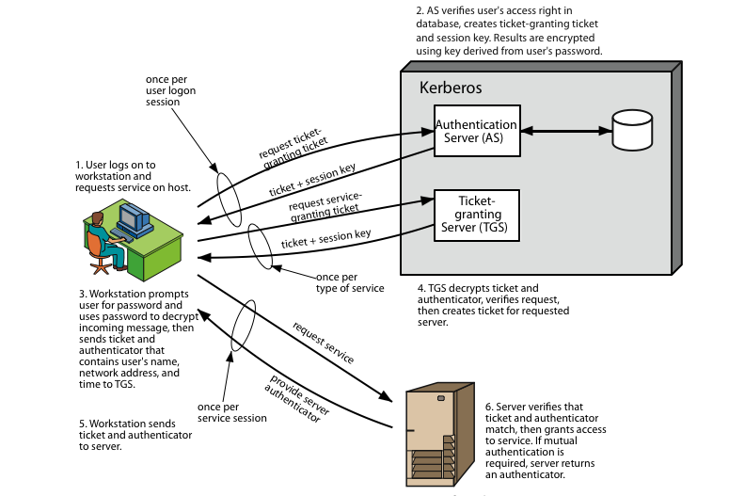
Kerberos 4 Overview
Notes:
Stallings Figure 14.1 diagrammatically summarizes the Kerberos v4 authentication dialogue, with 3 pairs of messages, for each phase listed previously.

Slide 8
Kerberos Realms
a Kerberos environment consists of:
a Kerberos server
a number of clients, all registered with server
application servers, sharing keys with server
this is termed a realm
typically a single administrative domain
if have multiple realms, their Kerberos servers must share keys and trust
Notes:
A full-service Kerberos environment consisting of a Kerberos server, a number of clients, and a number of application servers is referred to as a Kerberos realm. A Kerberos realm is a set of managed nodes that share the same Kerberos database, and are part of the same administrative domain. If have multiple realms, their Kerberos servers must share keys and trust each other.

Slide 9
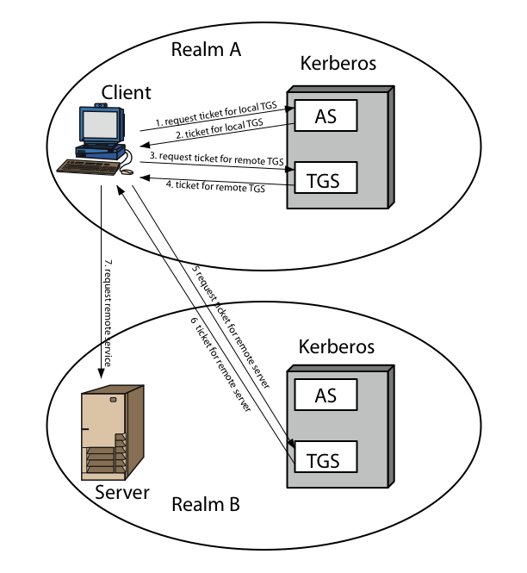
Kerberos Realms
Notes:
Stallings Figure 14.2 shows the authentication messages where service is being requested from another domain. The ticket presented to the remote server indicates the realm in which the user was originally authenticated. The server chooses whether to honor the remote request. One problem presented by the foregoing approach is that it does not scale well to many realms, as each pair of realms need to share a key.

Slide 10
X.509 Authentication Service
part of CCITT X.500 directory service standards
distributed servers maintaining user info database
defines framework for authentication services
directory may store public-key certificates
with public key of user signed by certification authority
also defines authentication protocols
uses public-key crypto & digital signatures
algorithms not standardised, but RSA recommended
X.509 certificates are widely used
Notes:
X.509 is part of the X.500 series of recommendations that define a directory service, being a server or distributed set of servers that maintains a database of information about users.
X.509 defines a framework for the provision of authentication services by the X.500 directory to its users. The directory may serve as a repository of public-key certificates. In addition, X.509 defines alternative authentication protocols based on the use of public-key certificates. X.509 is based on the use of public-key cryptography and digital signatures. The standard does not dictate the use of a specific algorithm but recommends RSA.
The X.509 certificate format is widely used, in for example S/MIME, IP Security and SSL/TLS and SET.

Slide 11
X.509 Certificates
issued by a Certification Authority (CA), containing:
version (1, 2, or 3)
serial number (unique within CA) identifying certificate
signature algorithm identifier
issuer X.500 name (CA)
period of validity (from - to dates)
subject X.500 name (name of owner)
subject public-key info (algorithm, parameters, key)
issuer unique identifier (v2+)
subject unique identifier (v2+)
extension fields (v3)
signature (of hash of all fields in certificate)
notation CA<<A>> denotes certificate for A signed by CA
Notes:
The X.509 certificate is the heart of the standard. There are 3 versions, with successively more info in the certificate - must be v2 if either unique identifier field exists, must be v3 if any extensions are used. These user certificates are assumed to be created by some trusted certification authority (CA) and placed in the directory by the CA or by the user. The directory server itself is not responsible for the creation of public keys or for the certification function; it merely provides an easily accessible location for users to obtain certificates. The certificate includes the elements shown.
The standard uses the notation for a certificate of: CA<<A>> where the CA signs the certificate for user A with its private key.

Slide 12
Obtaining a Certificate
any user with access to CA can get any certificate from it
only the CA can modify a certificate
because cannot be forged, certificates can be placed in a public directory
Notes:
User certificates generated by a CA have the characteristics that any user with access to the public key of the CA can verify the user public key that was certified, and no party other than the certification authority can modify the certificate without this being detected. Because certificates are unforgeable, they can be placed in a directory without the need for the directory to make special efforts to protect them.

Slide 13
Authentication Procedures
X.509 includes three alternative authentication procedures:
One-Way Authentication
Two-Way Authentication
Three-Way Authentication
all use public-key signatures
Notes:
X.509 also includes three alternative authentication procedures that are intended for use across a variety of applications, used when obtaining and using certificates. 1-way for unidirectional messages (like email), 2-way for interactive sessions when timestamps are used, 3-way for interactive sessions with no need for timestamps (and hence synchronised clocks). See Stallings Figure 14.6 for details of each of these alternatives.

Slide 14
Summary
have considered:
Kerberos trusted key server system
X.509 authentication and certificates
Notes:
Chapter 14 summary.

